Slide 1
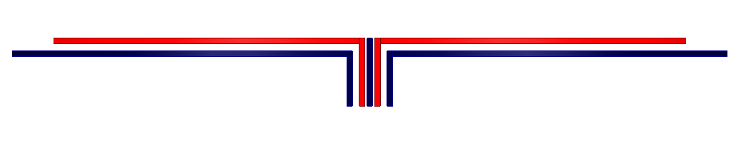
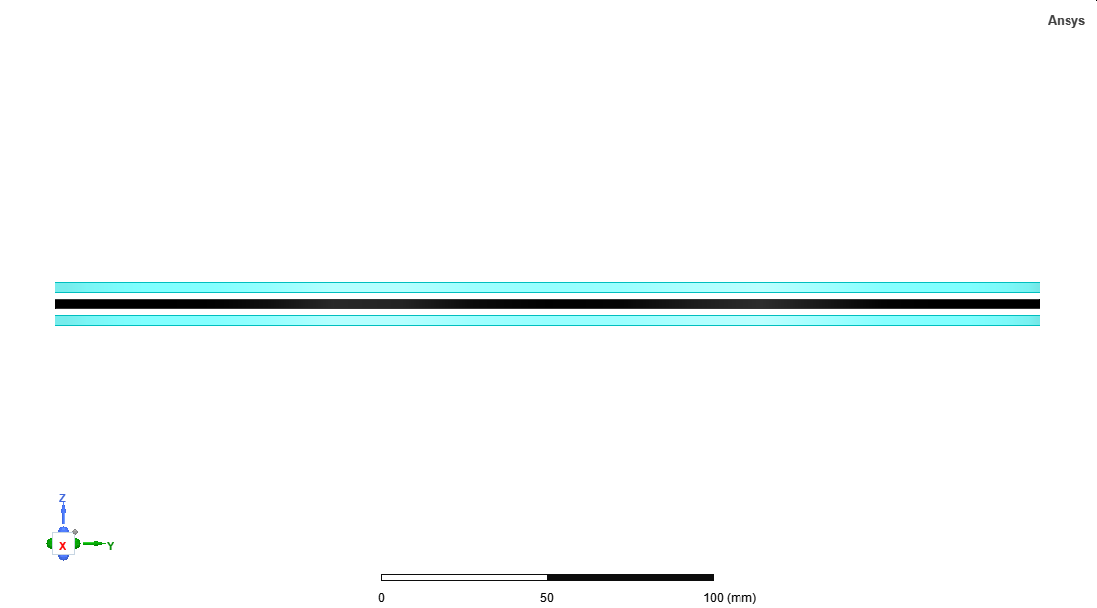
Tx1
Ferrite
Tx2
Ferrite
Ferrite
MSR
(a)
Ferrite
MSR
(b)

